Slide 1
Classifier project:
No Student Left Behind

Slide 2
Random Forest
The main idea behind random forest is that lots of high variance and low bias trees combine to generate a low bias low variance forest. Since it is distributed over different trees and each tree sees different set of data , therefore random forest in general do not over fit. And since they are made of low bias trees, underfitting also does not happen.

Slide 3
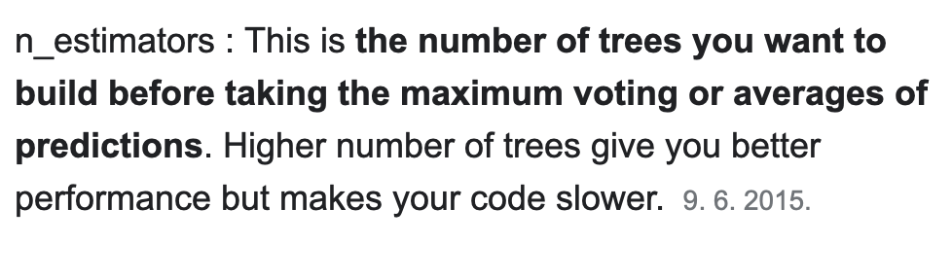
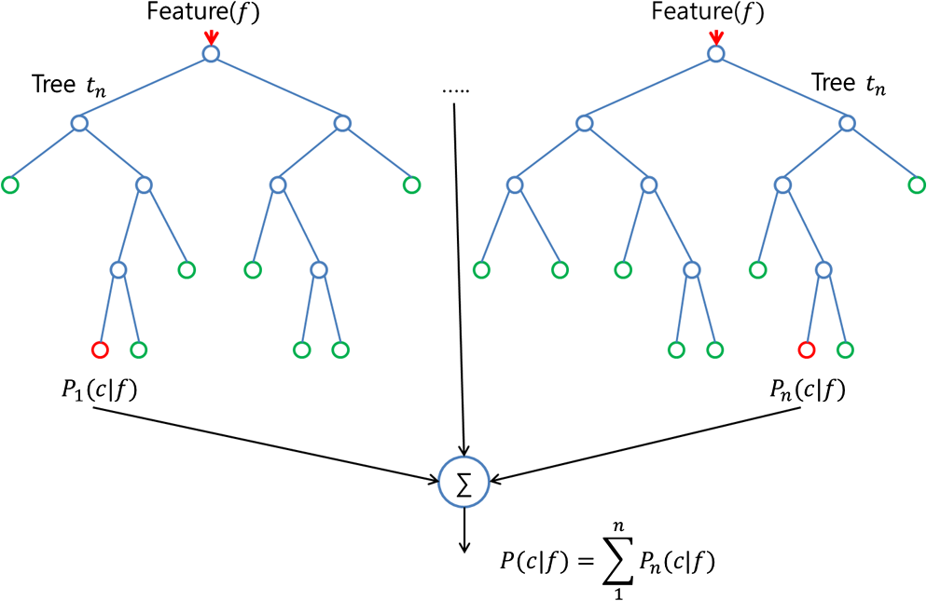
Random Forest

Slide 4
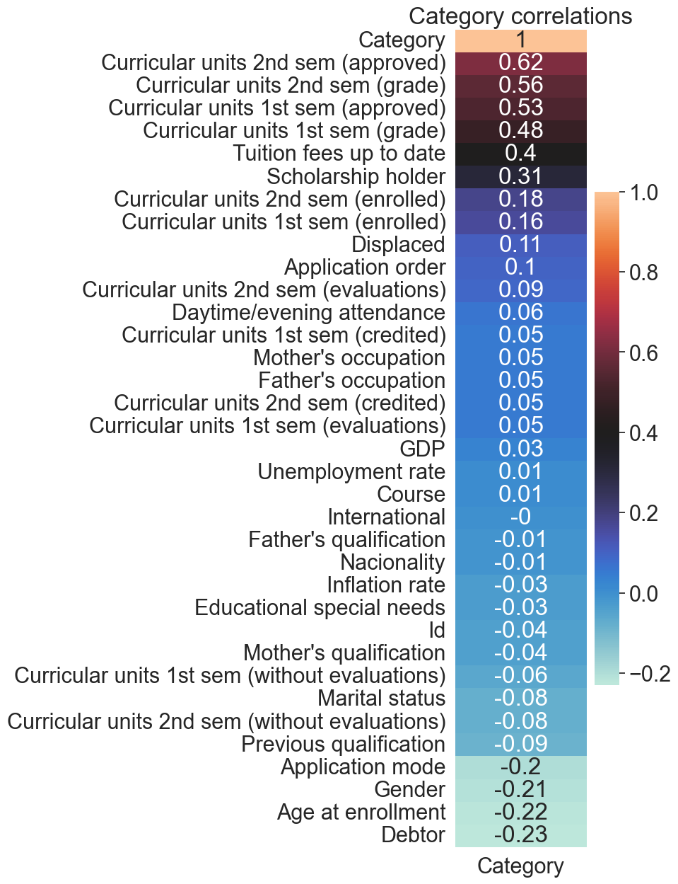
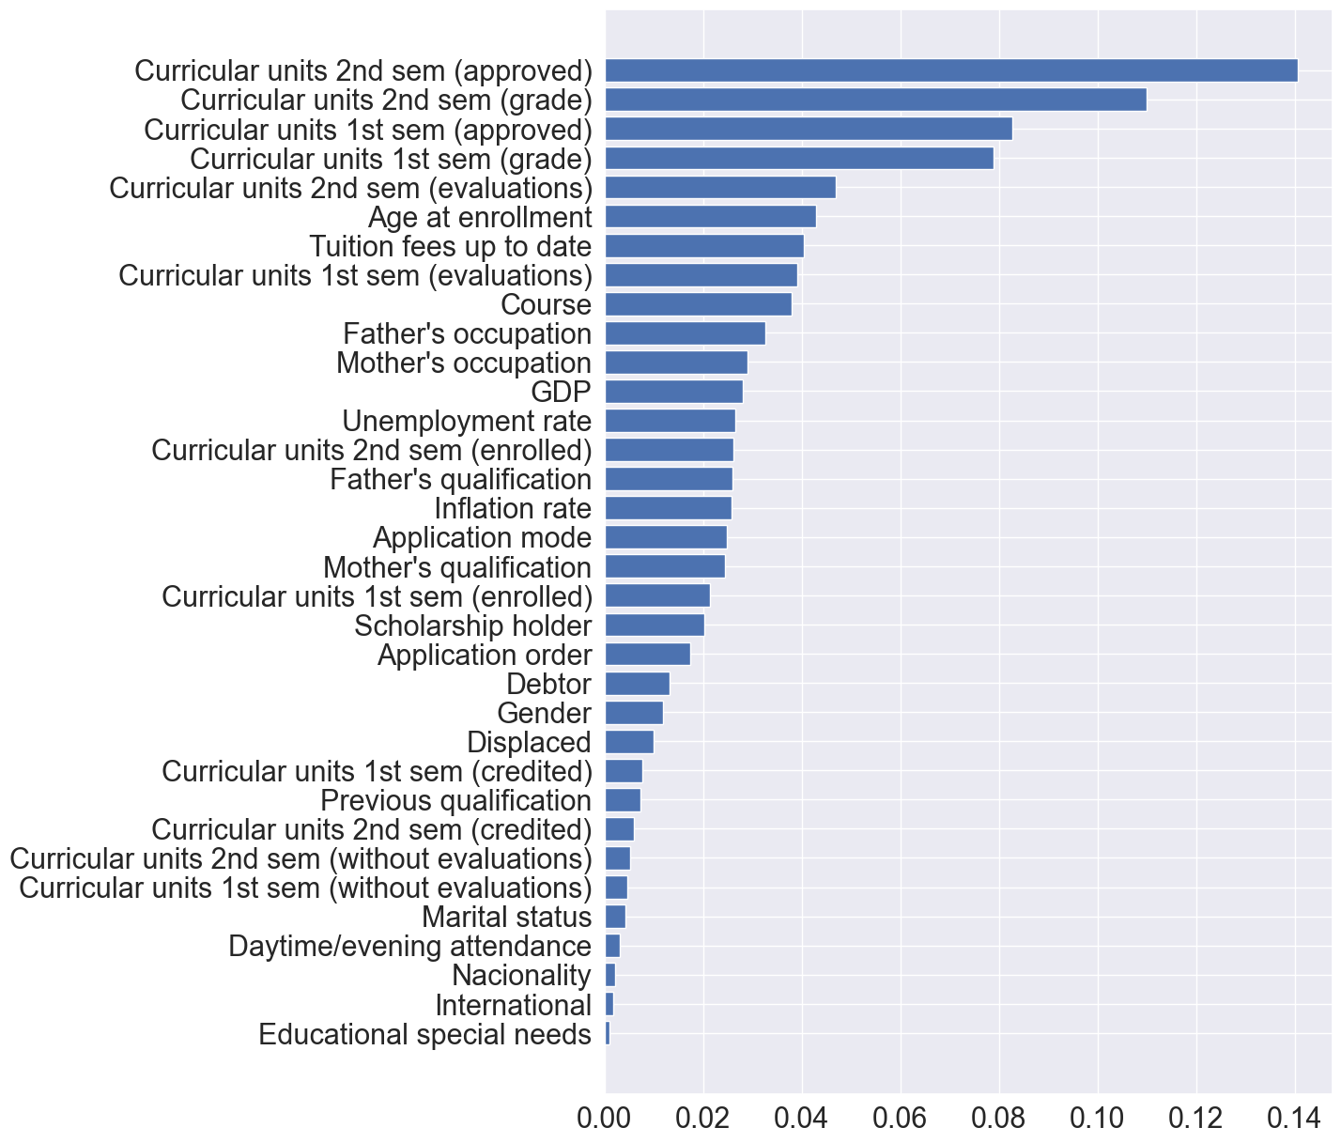
Model’s feature importances

Slide 5
Model’s feature importances

Slide 6
precision recall f1-score support
Dropout 0.75 0.79 0.77 421
Enrolled 0.29 0.47 0.36 151
Graduate 0.91 0.78 0.84 756
accuracy 0.74 1328
macro avg 0.65 0.68 0.65 1328
weighted avg 0.79 0.74 0.76 1328

Slide 7
Prediction accuracy
Model accuracy score on training data: 1.0
Model accuracy score on test data: 0.7643072289156626
Overfitted
Balanced accuracy: 0.6811409922224341
F1 score: 0.7535770141436976

Slide 8
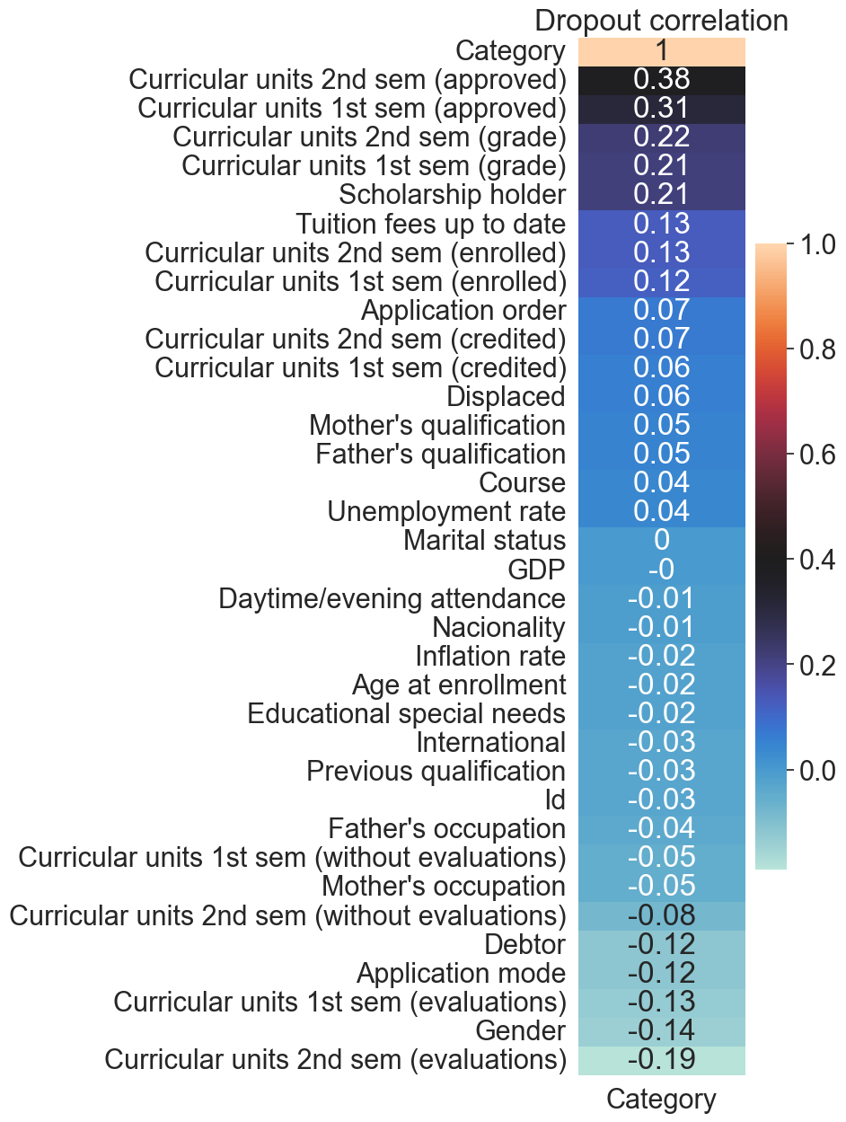
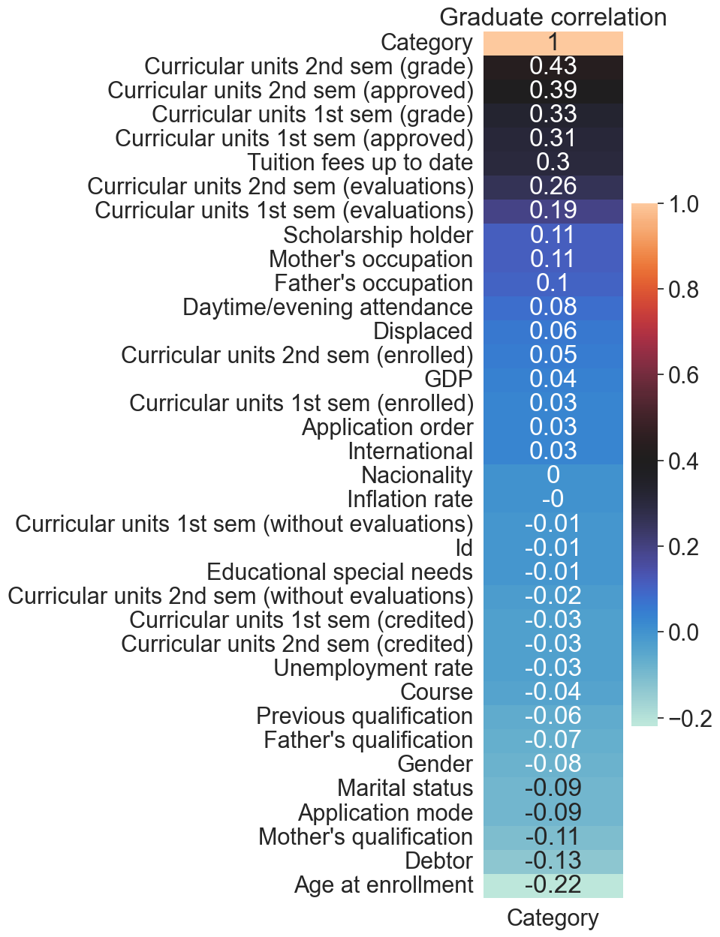

Slide 11
Shallow decision trees (e.g. few levels) generally do not overfit but have poor performance (high bias, low variance). Whereas deep trees (e.g. many levels) generally do overfit and have good performance (low bias, high variance). A desirable tree is one that is not so shallow that it has low skill and not so deep that it overfits the training dataset.

Slide 12
